Slide 1
Artificial Intelligence Coursework Presentation

Slide 2

Presented By: Prakash Pandeya 22068109

Slide 3
Agenda of this presentation:
1. Introduction to the Topic:
About the dataset and the system developed.
Explanation of the AI concepts used.
Research Evidences.
Research for selection of the topic.
2. Solution:
Explanation of the solution and developed application (how it works.)
Achieved Results.
How it solves real world problems?
3. Synthesis of Information:
Pesudo code for the solution.
Diagrammatical representations of the solution (flowcharts/state transition diagrams)
4. Conclusion

Slide 4
Recipe Recommendation System
This presentation explores the development of a recipe recommendation system using machine learning algorithms.
The system leverages user feedback data to provide personalized recipe suggestions.
Let’s Begin:-

Slide 5
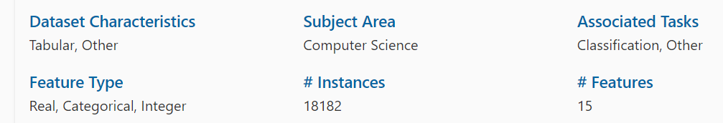
About Dataset
Name of the dataset: Recipe Review And User Feed Back Dataset
Dataset Exported from : https://archive.ics.uci.edu/dataset/911/recipe+reviews+and+user+feedback+dataset

Slide 6
Why I selected This Dataset?
Because:
It is a comprehensive repository of data encompassing various aspects of recipe reviews and user interactions.
Users' sentiment towards recipes is quantified on a 1 to 5 star rating scale, with a score of 0 denoting an absence of rating.
This dataset is a valuable resource for researchers and data scientists, facilitating endeavors in sentiment analysis, user behavior analysis, recipe recommendation systems, and more.
It offers a window into the dynamics of recipe reviews and user feedback within the culinary website domain.

Slide 7
Pipeline Followed to develop System:
Imported Dataset
Read Dataset
Displayed head/tail/sample
Shown total rows and columns
Shown the datatype of each column
Removed Unnecessary Columns
Converted categorical column to numerical column
8. Splitted the dataset into features and Target.
9. Trained the Model
10. Predicted suing the trained Model
11. Evaluated the Model

Slide 8
The AI concepts and algorithms used to build this application are as follows:
Finds the nearest recipes based on user input values for the selected features.
K-Nearest Neighbors (KNN):
Purpose: Recipe recommendation based on user preferences. It helps to find the nearest recipes based on user input values for the selected features.
How KNN works?
-KNN works by finding recipes that are most similar to the input recipe or user preferences.

Slide 9
Why I used KNN here?
It is so because I have a clear set of numerical features like thumbs_up, thumbs_down, stars, best_score, etc. that defines a recipe.
And KNN naturally compares these numerical features to find similar recipes.
KNN doesn’t require complex training; it simply stores the data and compares it at runtime. So, it is ease of use.
Some features like thumbs_up or best_score might have large values compared to others. To ensure KNN compares all features equally, scaling is applied to bring all features to the same range.
Finds the nearest recipes based on user input values for the selected features.

Slide 10
The AI concepts and algorithms used to build this application are as follows:
Finds the nearest recipes based on user input values for the selected features.
2. Random Forest:
Purpose: Used to classify recipes based on their attributes and recommend them respectively.
What is Random Forest?
- Random Forest is algorithm that combines multiple decision trees to improve classification accuracy and robustness. Each tree in the forest makes a prediction, and the final output is determined by a majority vote or averaging.

Slide 11
Why I used Random Forest? I used Random Forest because: Why I used Random Forest? I used Random Forest because: Why I used Random Forest? I used Random Forest because: Why I used Random Forest? I used Random Forest because: Why I used Random Forest here?
It is so because it handles Multi-Class Classification. Here, the recipe_name column has multiple classes i.e. different recipe names) and Random Forest is well suited here.
Provides us insights through feature importance to understand the relationship between attribuytes and the recipes.

Slide 12
The AI concepts and algorithms used to build this application are as follows:
Finds the nearest recipes based on user input values for the selected features.
3. K-means Clustering:
Purpose: Groups recipes into clusters based on their similarities across features.
Why I used K-Means Clustering here?
In order to group recipes that share similar attributes, making it easier to recommend recipes within the same cluster.
Recipes in the same cluster as a user’s liked recipe are likely to be similar and can be recommended.
Clustering can be combined with supervised methods (e.g., Random Forest or KNN) to refine recommendations further.

Slide 13
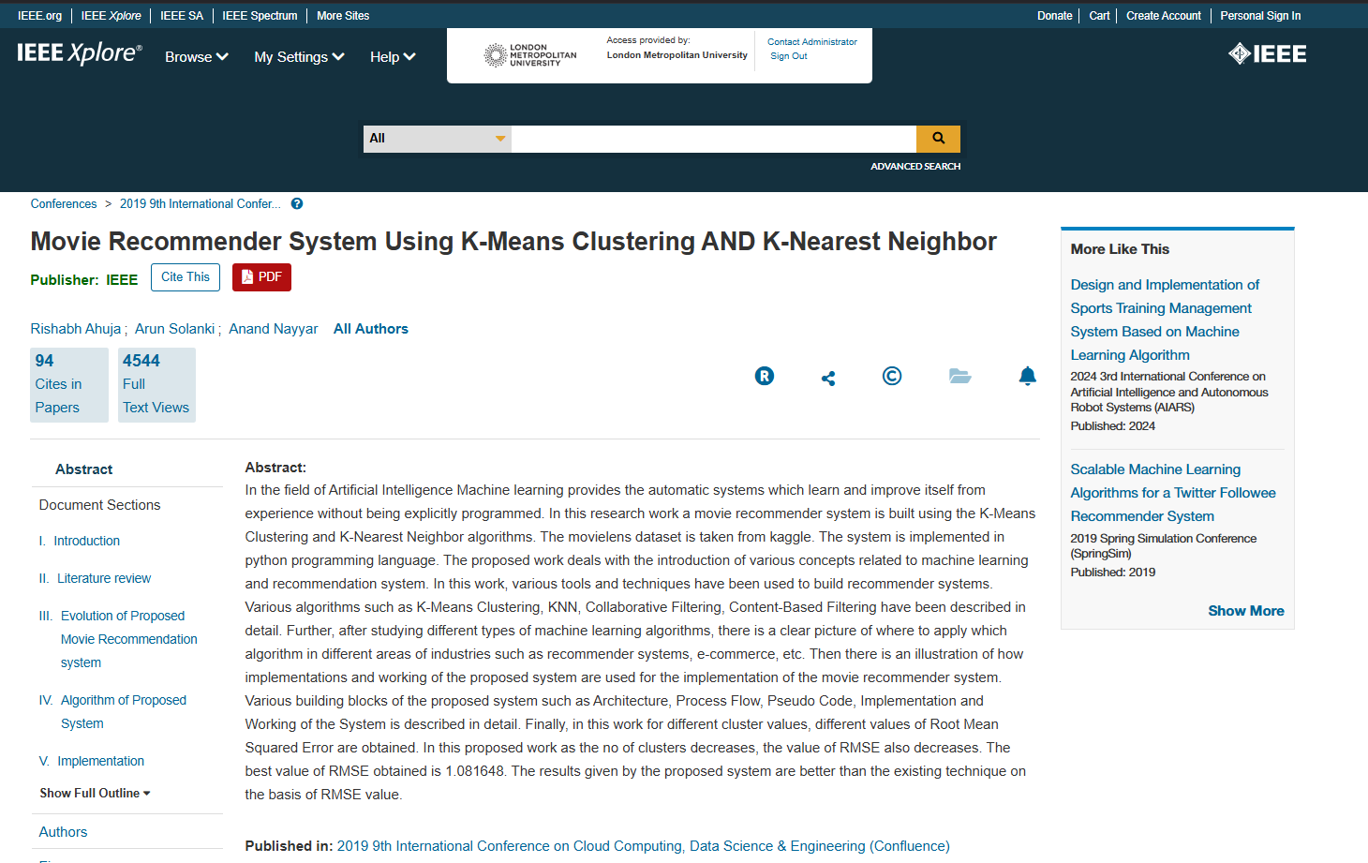
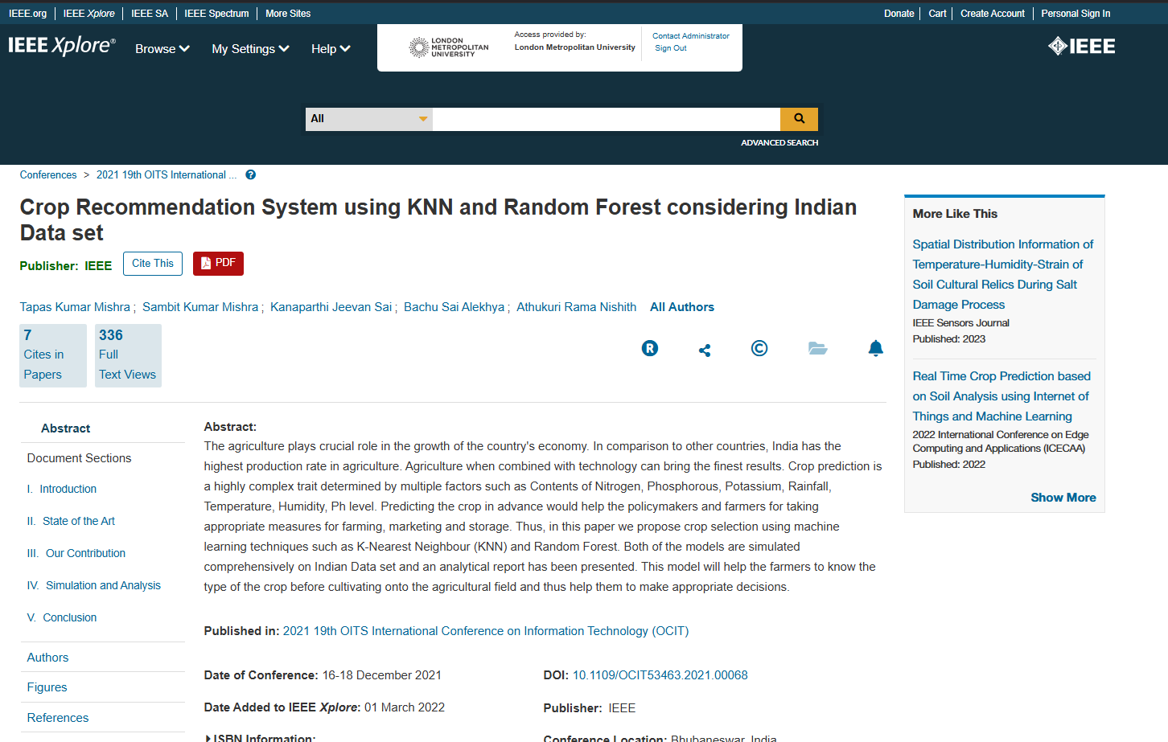
Research evidences

Slide 14
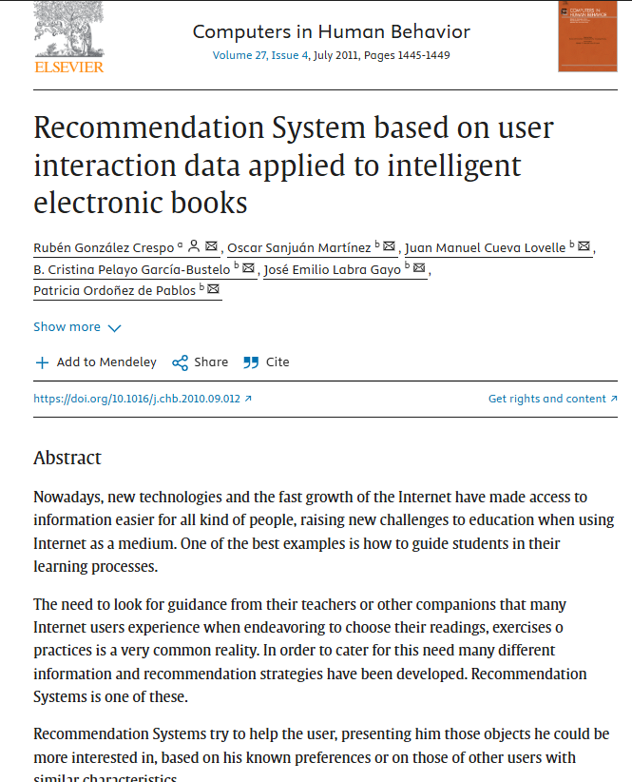
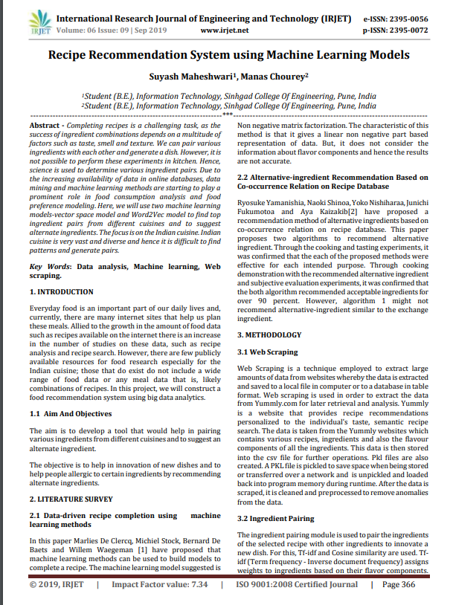
Research evidences

Slide 15
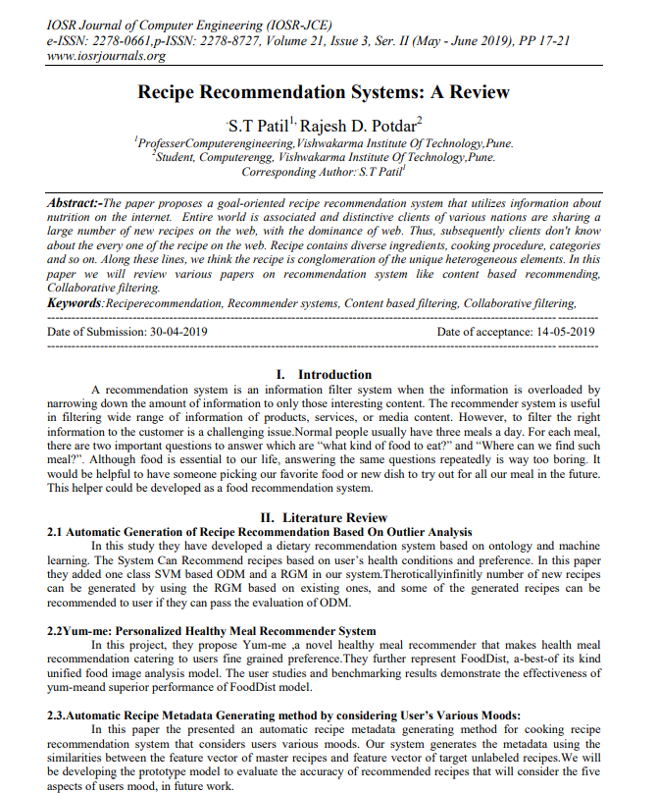
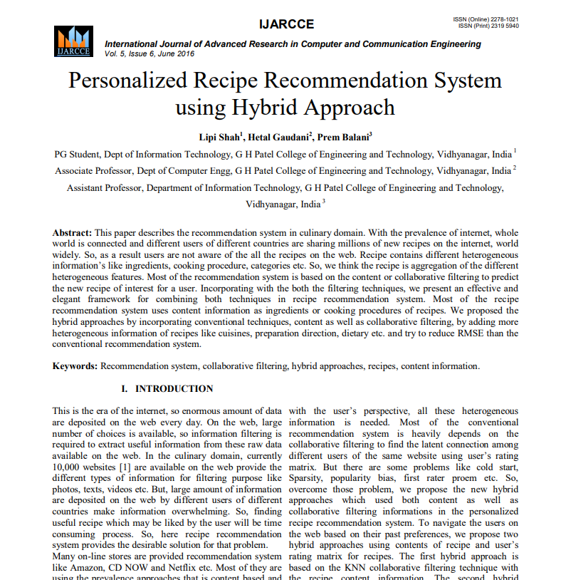
Research evidences

Slide 16
Reason for selection of the topic: The main reason why I selected this topic is because of the dataset that I have got. Well to elaborate, I got a dataset named as “Recipe Review And User Feedback”. And also, in our coursework we had the option choose recommendation system . So, To explore on how the actual recommendation system works , I chose this topic.

Slide 17
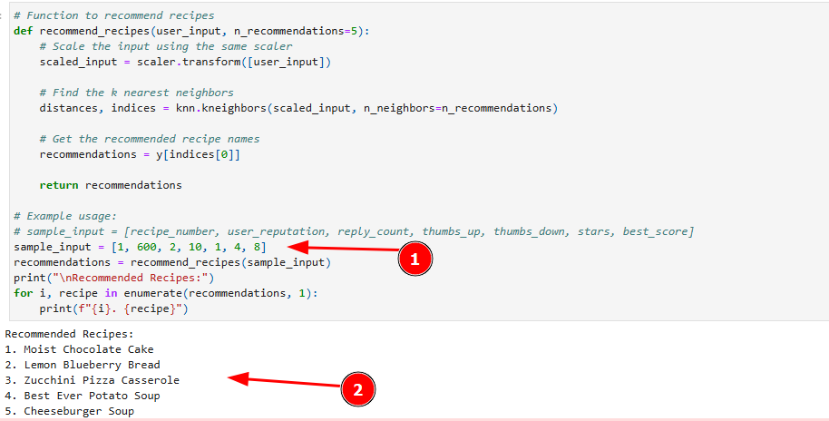
Explanation of the solution and developed application
After training the model through 3 different algorithms. User can get recommended about the other similar recipe based on the features they input.
Here using KNN algorithm, if we input the features [recipe_number, user_reputation, reply_count, thumbs_up, thumbs_down, stars, best_score], then based on that data we are recommended a certain recipe with same features.

Slide 18
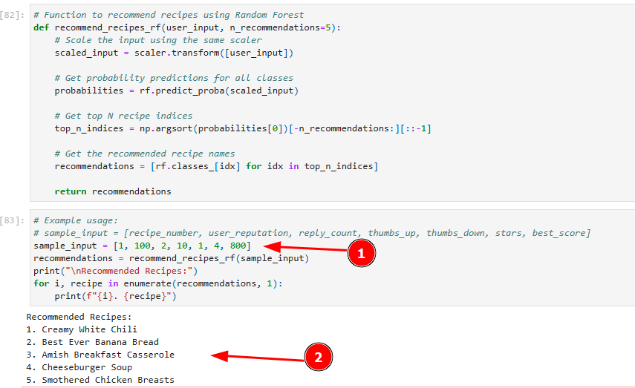
Explanation of the solution and developed application
2. Here using Random Forest algorithm, if we input the features [recipe_number, user_reputation, replycount, thumbs_up, thumbs_down, stars, best_score], then based on that data we are recommended a certain recipe with same features as shown in the figure

Slide 19
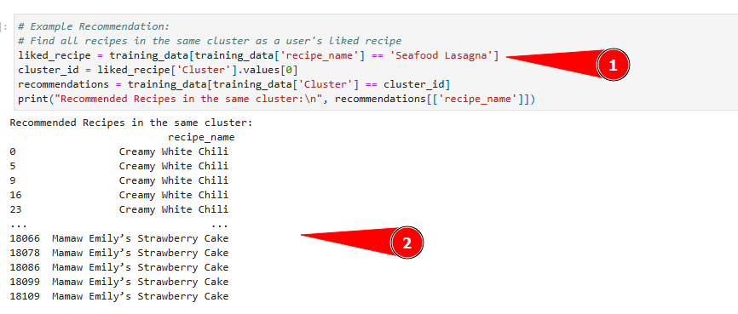
Explanation of the solution and developed application
2. Using K-means clustering algorithm, if we input the recipe name, then we get the recommended recipes in the same clusters.

Slide 20
How it solves real world problems?
The ultimate solution that we get after solving the dataset is the recipe recommendation based on user ratings. This recipe recommendation is simple and effective for the users and with some more changes and advancement on the dataset the business can also flourish in the domain of food and recipes. This solution helps to address the struggle faced by the users in finding recipes that match their preferences and improve their experience. Using the featured column like stars, thumbs_up, best_score, etc. that are tested and trained under the 3 different algorithms, users are recommended the recipes similar to the one that they have previously liked. Time utilization is the most necessary thing in the today’s world and this solution helps users to manage time that they spent mostly in search of recipe. The related business personnel can adapt this recommendation system and provide their customers with the ultimate facility of choosing the best recipe.

Slide 21
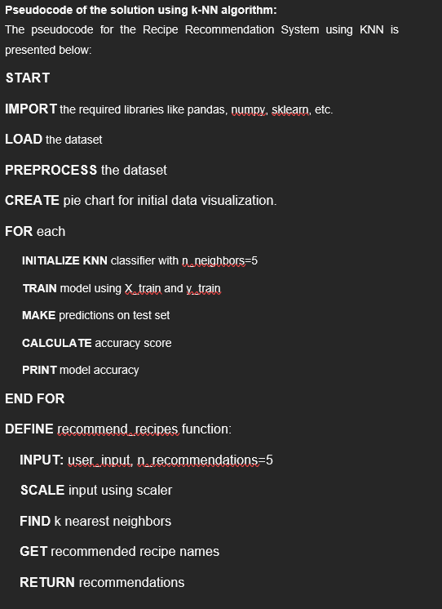
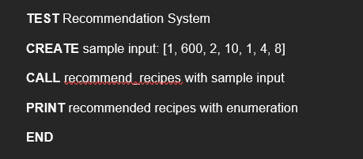
Pseudo code for the solution using KNN

Slide 22
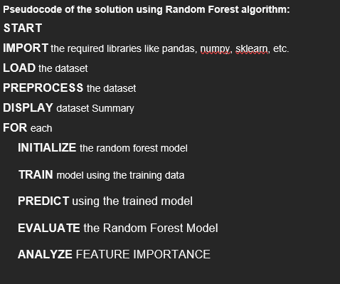
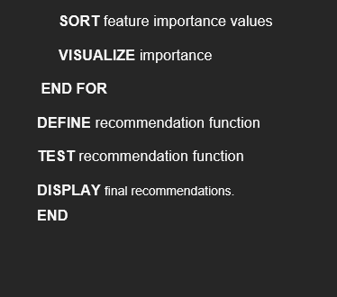
Pseudo code for the solution using Random Forest

Slide 23
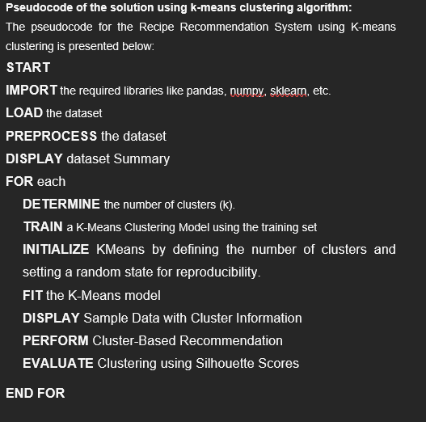
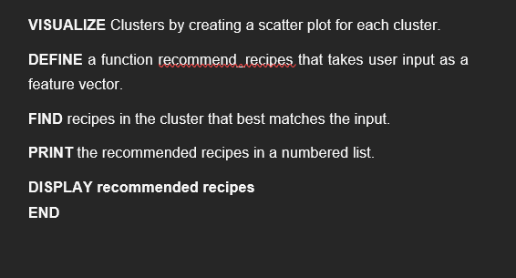
Pseudo code for the solution using K-means Clustering

Slide 24
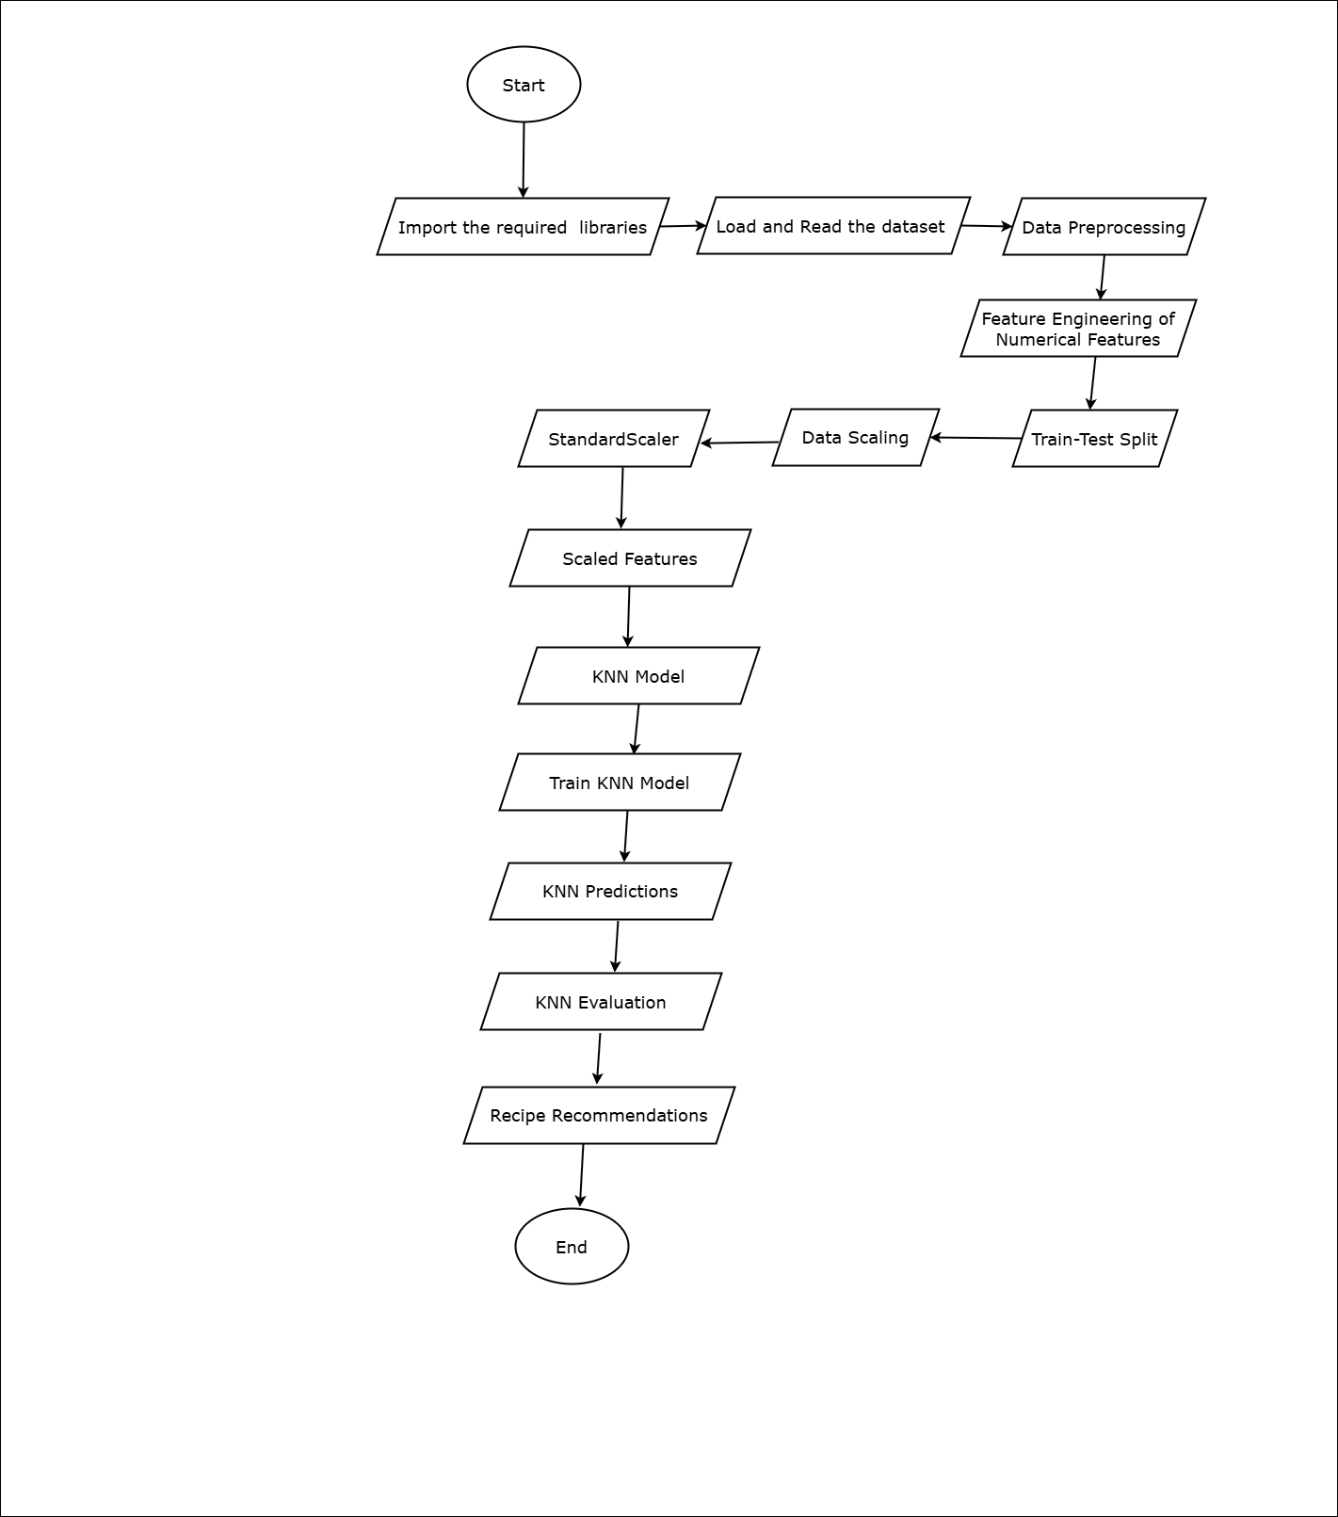
Flow Chart of the solution by KNN

Slide 25
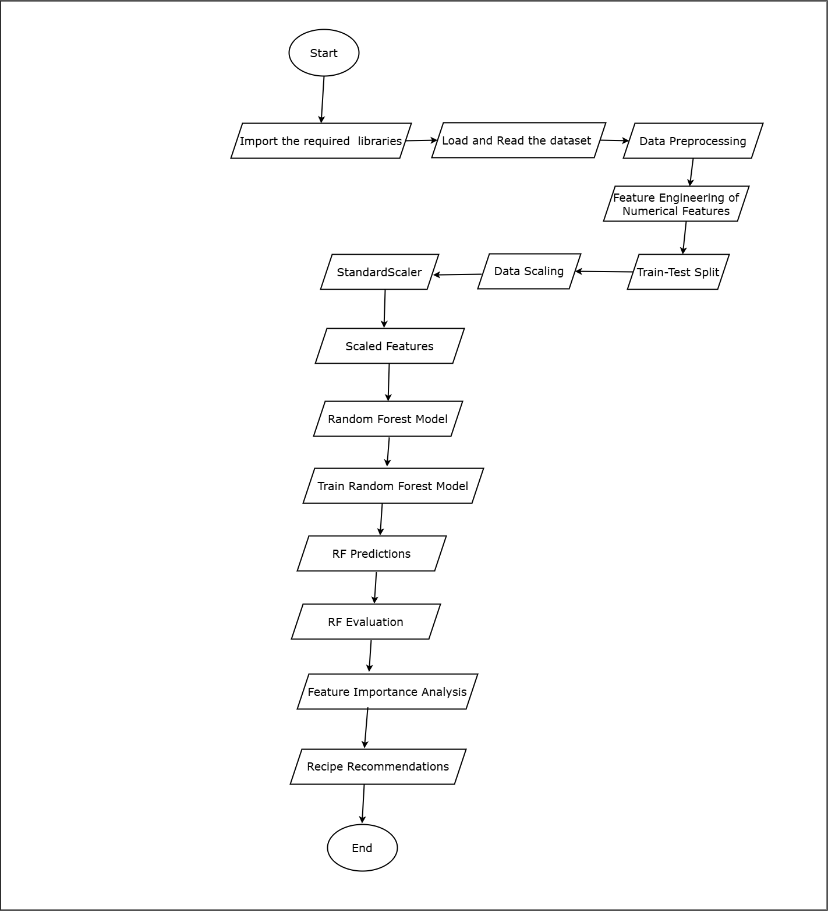
Flow Chart of the solution by Random Forest

Slide 26
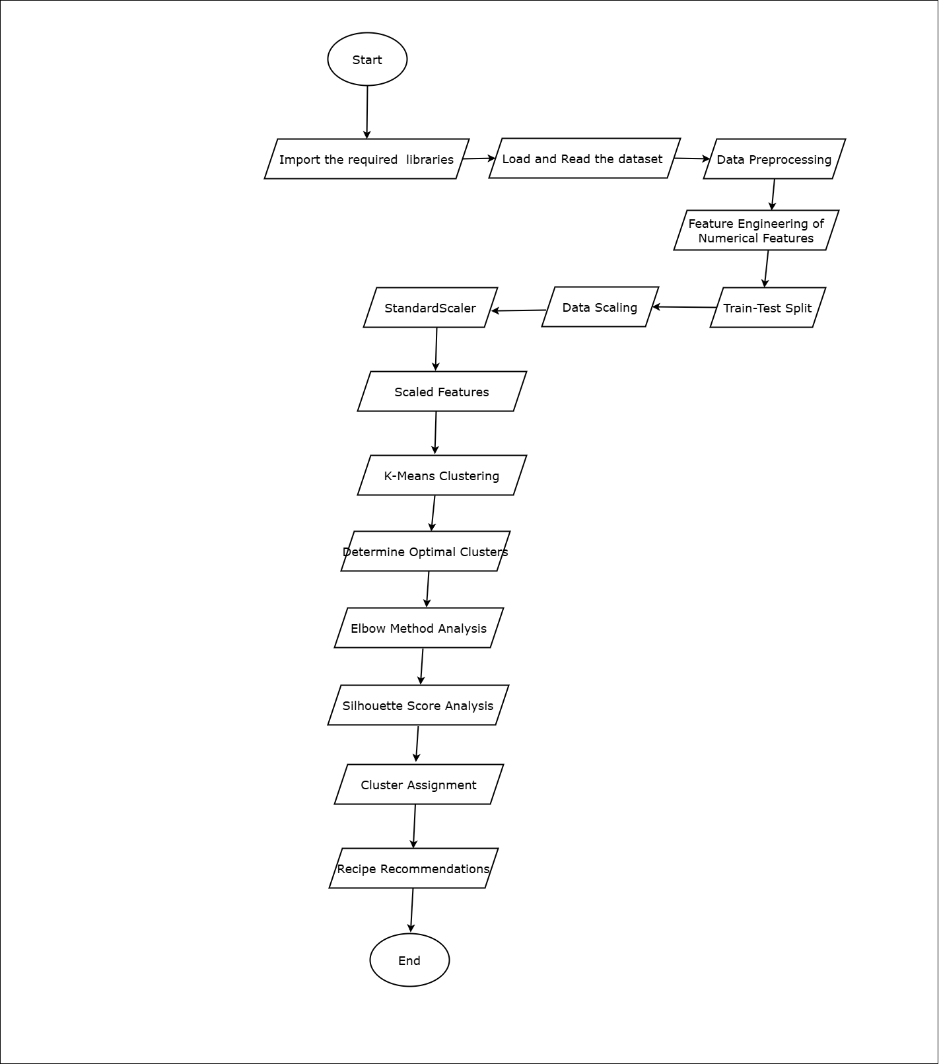
Flow Chart of the solution by K means Clustering:

Slide 27
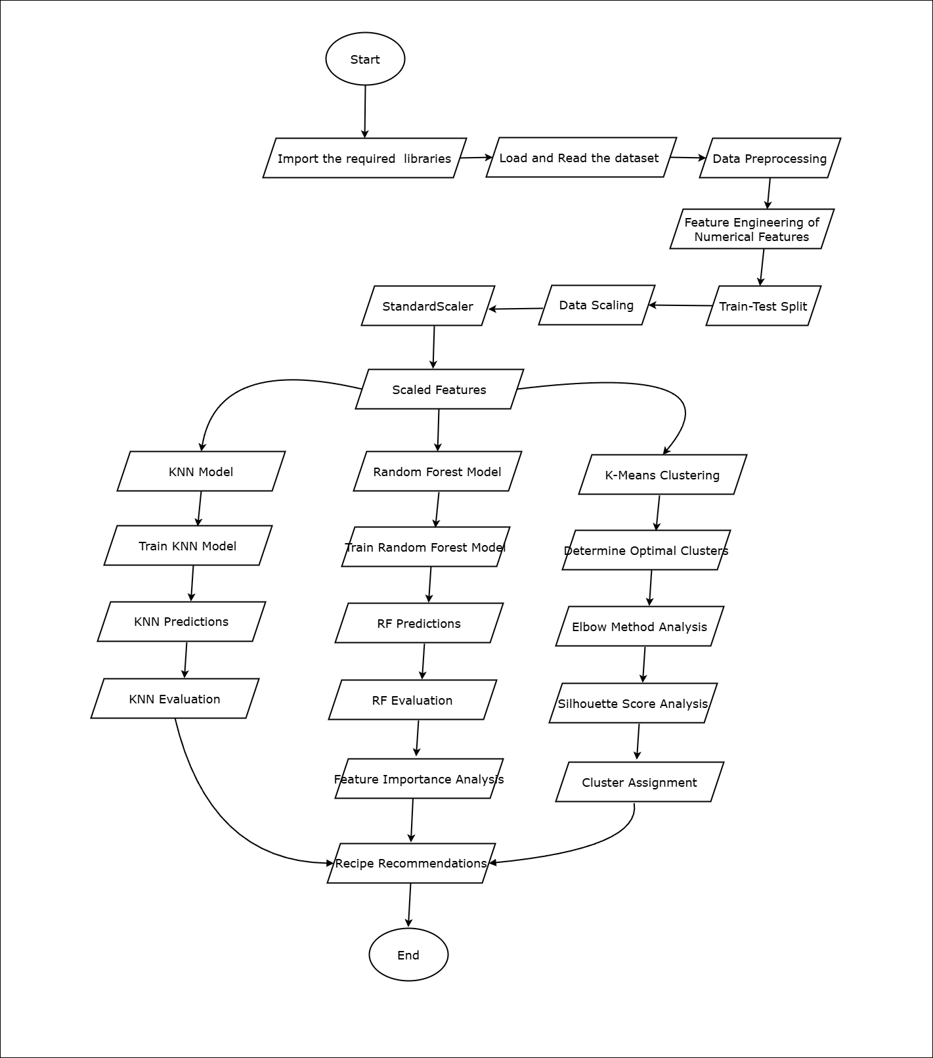
Flow Chart of the Entire Solution:

Slide 28
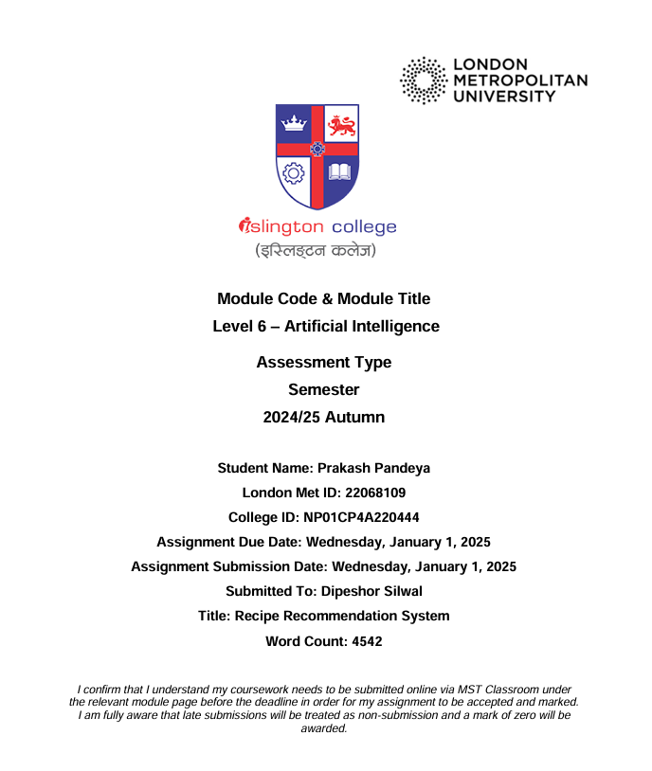
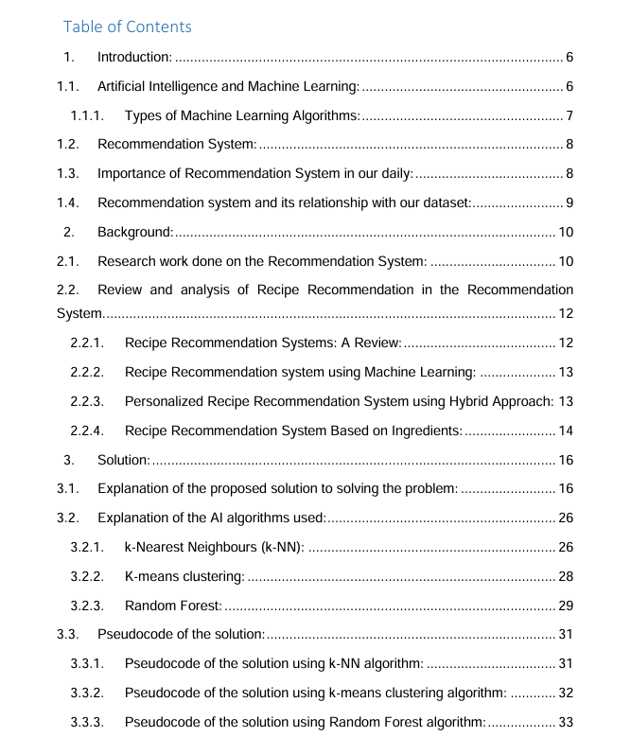
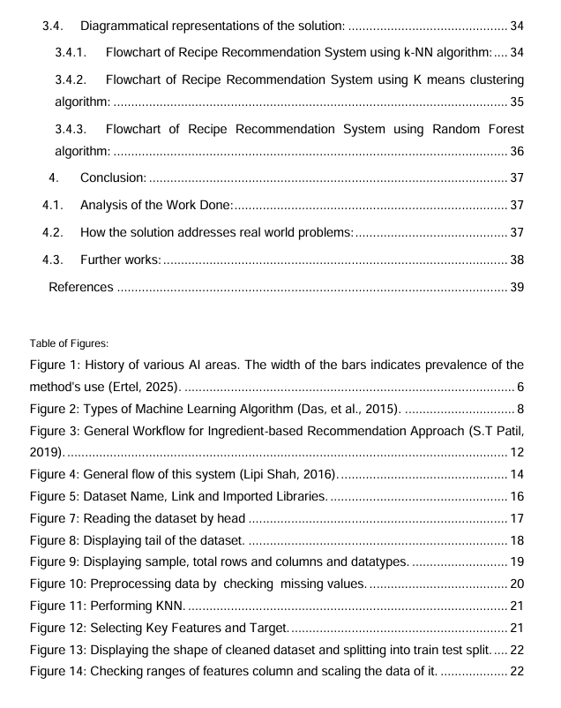
About the Report Prepared.

Slide 29
Thank you
Prakash Pandeya
C12

